Slide 1
Differentiation in the Latin Classroom
It’s easier than you think!

Slide 2
Why Differentiate?
“By differentiating, I allow the students to show me what they can do versus what they can’t. I let them choose the end product that I will evaluate, and they can shine.”
--Angelika Becker, Carmel High School, Carmel, IN
Notes:
Letting your students show you what they know fits well with our ACTFL standards and the Standard-based grading presentations we’ve already had.

Slide 3
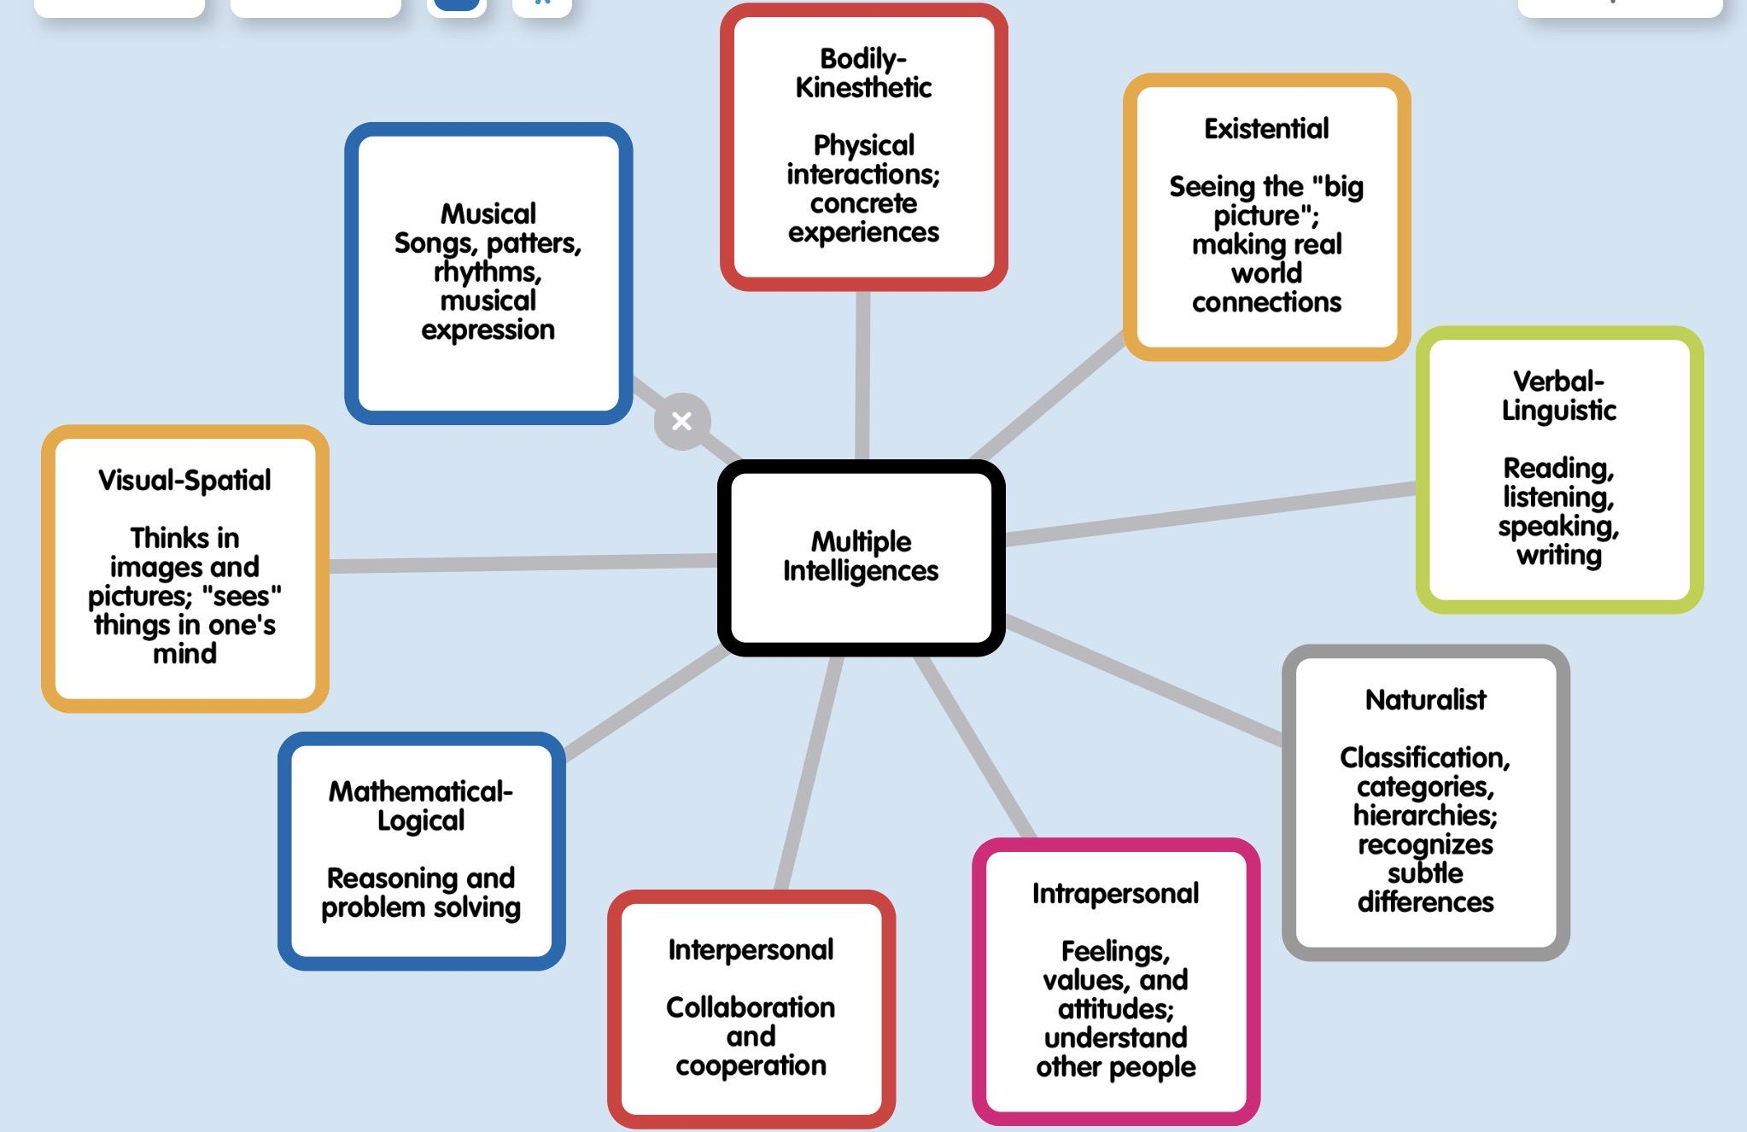
Notes:
When you consider differentiating your lessons, you should be considering multiple intelligences--so how do we get them touching, seeing, listing, moving, etc. And what lessons can fit into these different categories?
Yesterday we moved a lot, but we did it as one large group. Differentiated lessons really must allow for some student choice.
That does NOT mean that your students should be handed a list of 30 options and just told to go with one. Consider, ahead of time, maybe 3-4 activities that you would consider equal in difficulty and value. Think about the different intelligences that the activities could involve. Make sure that they touch on different categories.
An example might be: an iMovie summarizing the story, a written summary of the story, or a short storyboard/cartoon of the story.

Slide 4
Multiple Intelligences require Differentiation
If you accept that multiple intelligences exist, then the need for differentiation should be a consideration in all your lesson planning and curriculum writing.
A link to an MI test is attached here:
http://www.literacynet.org/mi/assessment/findyourstrengths.html

Slide 5
Differentiation vs Modification vs Accommodation
Differentiation is about allowing the student to choose the end product that best fits their learning style. You give them acceptable options, they get a choice.
Accommodation is about changing how or where a student learns, (e.g. front of the class, away from others, with fewer distractions, allowed to draw, etc.)
Modification is about changing what a student learns, (i.e. You simplify the assignment in some way for a specific student. This can ONLY be done for students who are SPED and have an IEP that specifies YOU must modify assignments and/or tests.

Slide 6
Differentiation and Language Objectives
Main TEKS (simplified): | Cambridge Course Objectives | IB Latin Objectives
Interpretive (Reading/Listening) | To be able to comprehend the Latin Language for reading purposes. | Understand and translate texts in the original language;
Interpersonal Speaking/Writing) | To develop an understanding of the content, style, and values, of Roman civilization, with special reference to first century A.D. | Demonstrate knowledge and understanding of texts in the original language...
Presentational (Speaking/Writing) |  | Analyze the style of , and demostrate a critical understanding of a varity of classical texts in the original language;
 |  | Construct an argument supported by relevant examples...

Slide 7
Possible Activities
Interpretive Read aloud in Latin Read to self in Latin Read and summarize Cultural Research Choral Reading Listen to Latin Watch video in Latin Respond to teacher’s questions Interpret short phrases Say/repeat short phrases | Interpersonal Class discussion Discussion based on targeted stimuli Latin games, songs, etc. Dramatic interpretation Short responses in Latin Worksheets Timed writes Simple conversations Fill in the blank | Presentational Language practice Presented research Orally reviewing a story/reading Translation Summary Illustration Creative writing/retelling Plot analysis Character analysis Interactive Note book interactions/reflections Reflection on any reading

Slide 8
Tic-Tac-Toe
Differentiation is about allowing student choice.
My favorite activity which I change often is an activity I modified from Toni Theisen.
This activity has 9 options and can be modified and used over and over.

Slide 9
Example--you decide the tasks, students choose 3
1 Interpretive Reading task | 2 Interpersonal Speaking task | 3 Art/handmade task
4 Culture task | 5 Interpretive Listening task | 6 Presentational Speaking task
7 Presentational Writing task | 8 Infographic/Digital Task | 9 Interpersonal Speaking task

Slide 10
Daily Differentiation--Allowing students to choose
Cartoons
Memes
One-pagers
Interactive Notebook Pages
Movies
Lip Dubs
Cooperative Google Docs
Videos

Slide 11
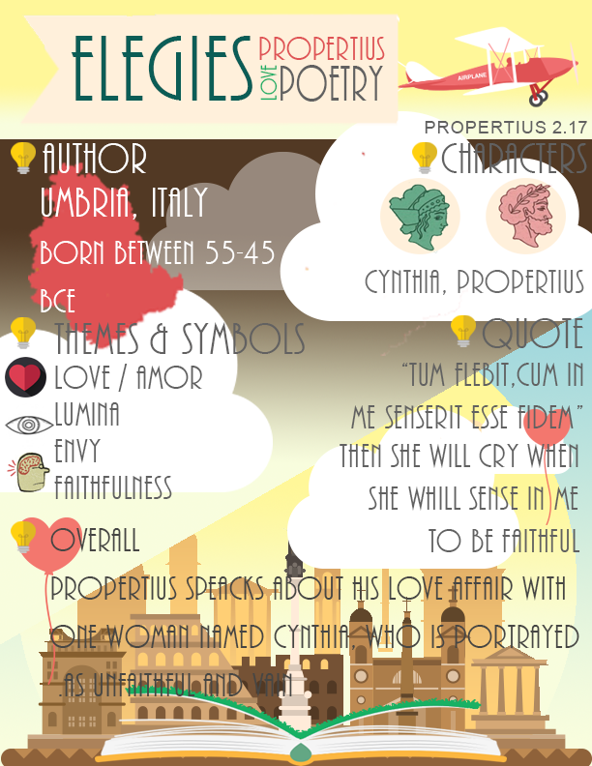
Including Technology
Iconography
Edited/subtitled videos
Educreations (app)
Meme Maker
Pictochart (app)
Poplet (app)

Slide 12
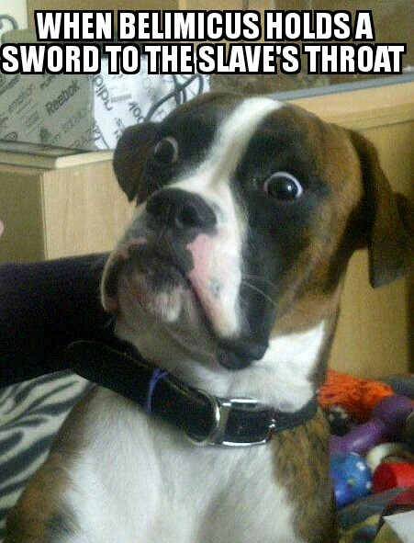
Memes
Notes:
Memes are one of my favorite activities for reading comprehension. The students are creative and they enjoy it.

Slide 13
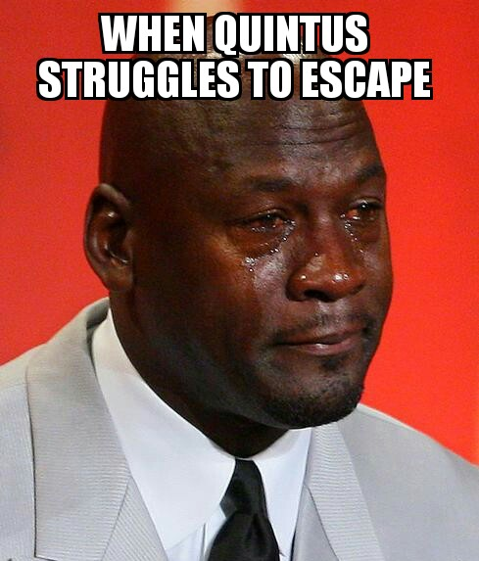
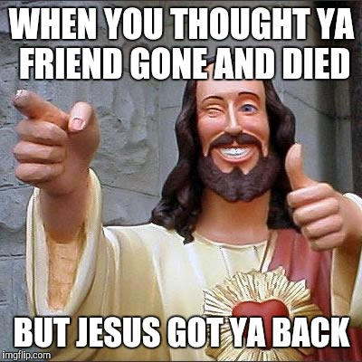
More Memes

Slide 14
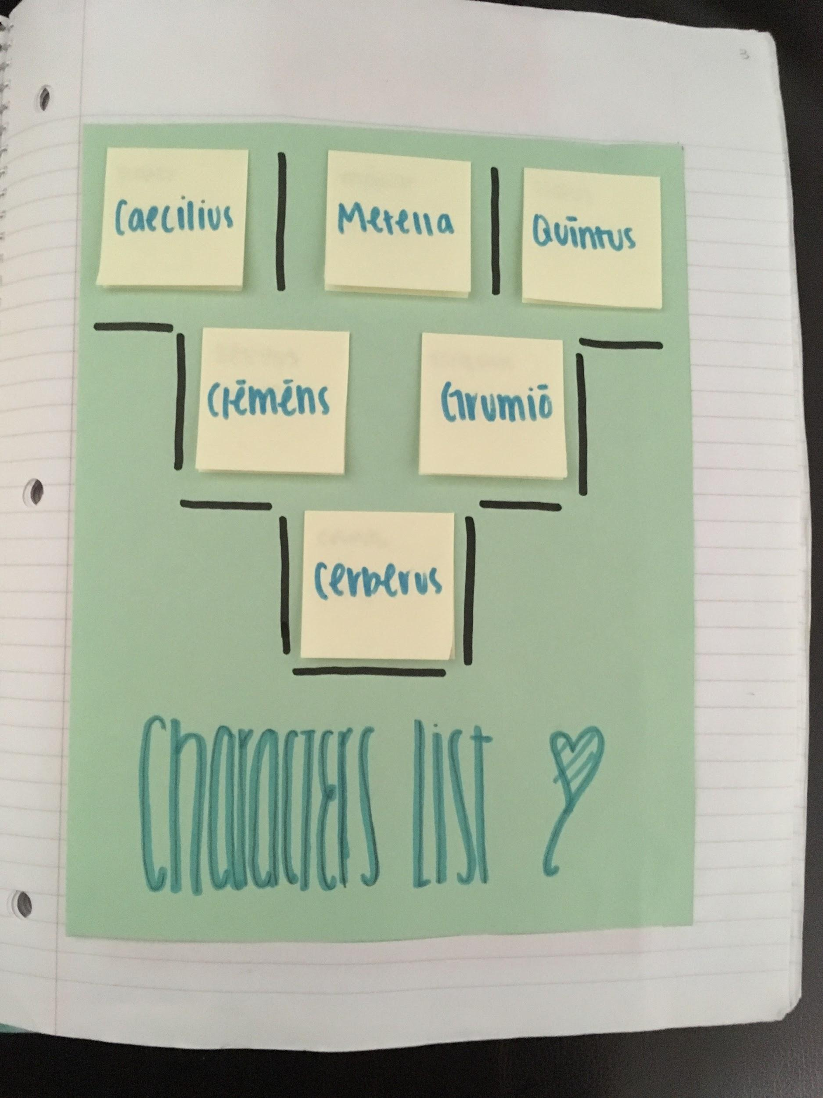
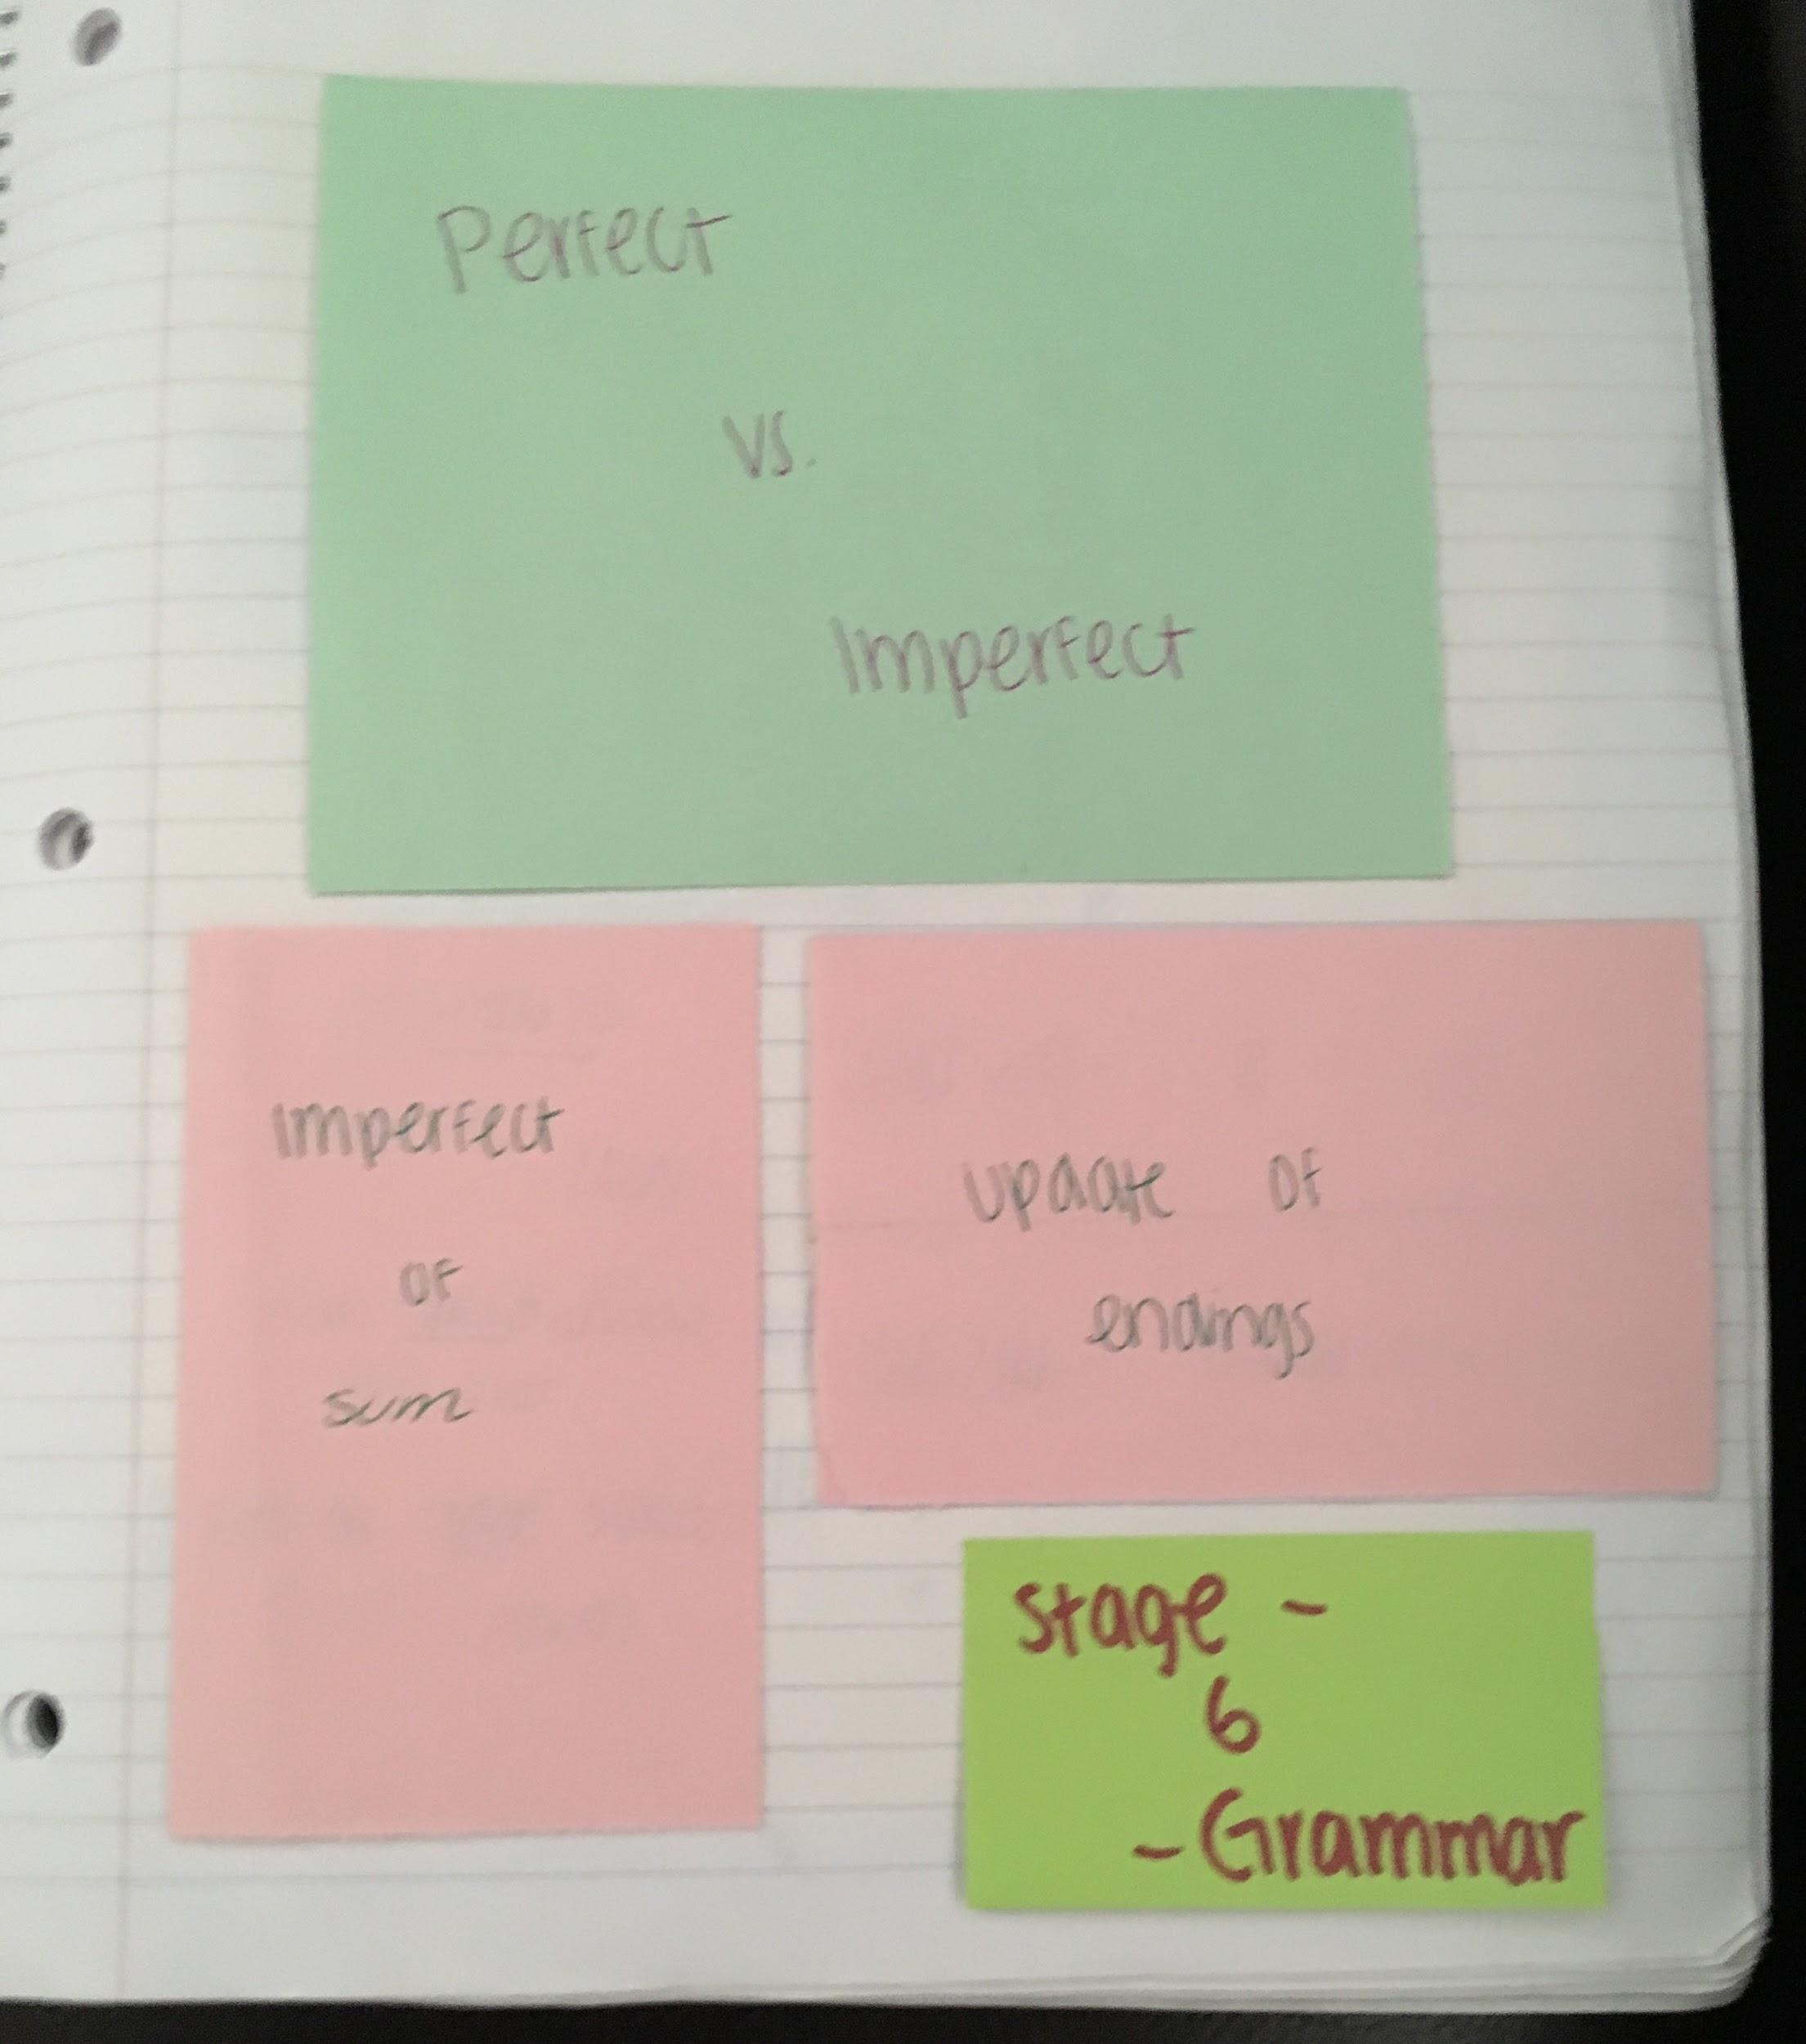
Interactive Notebook Examples
Notes:
Character analysis
grammar

Slide 15
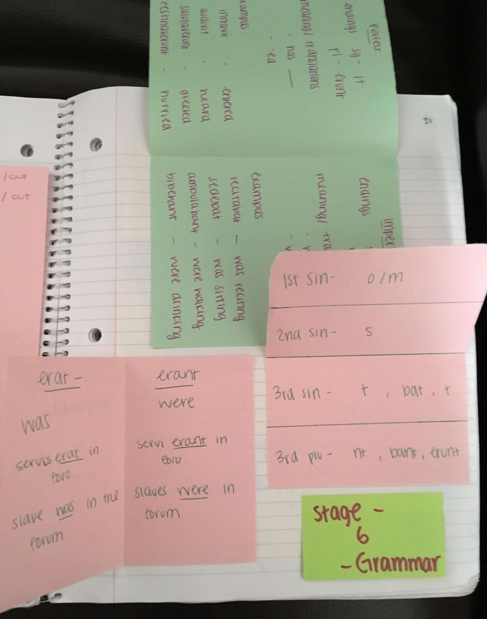
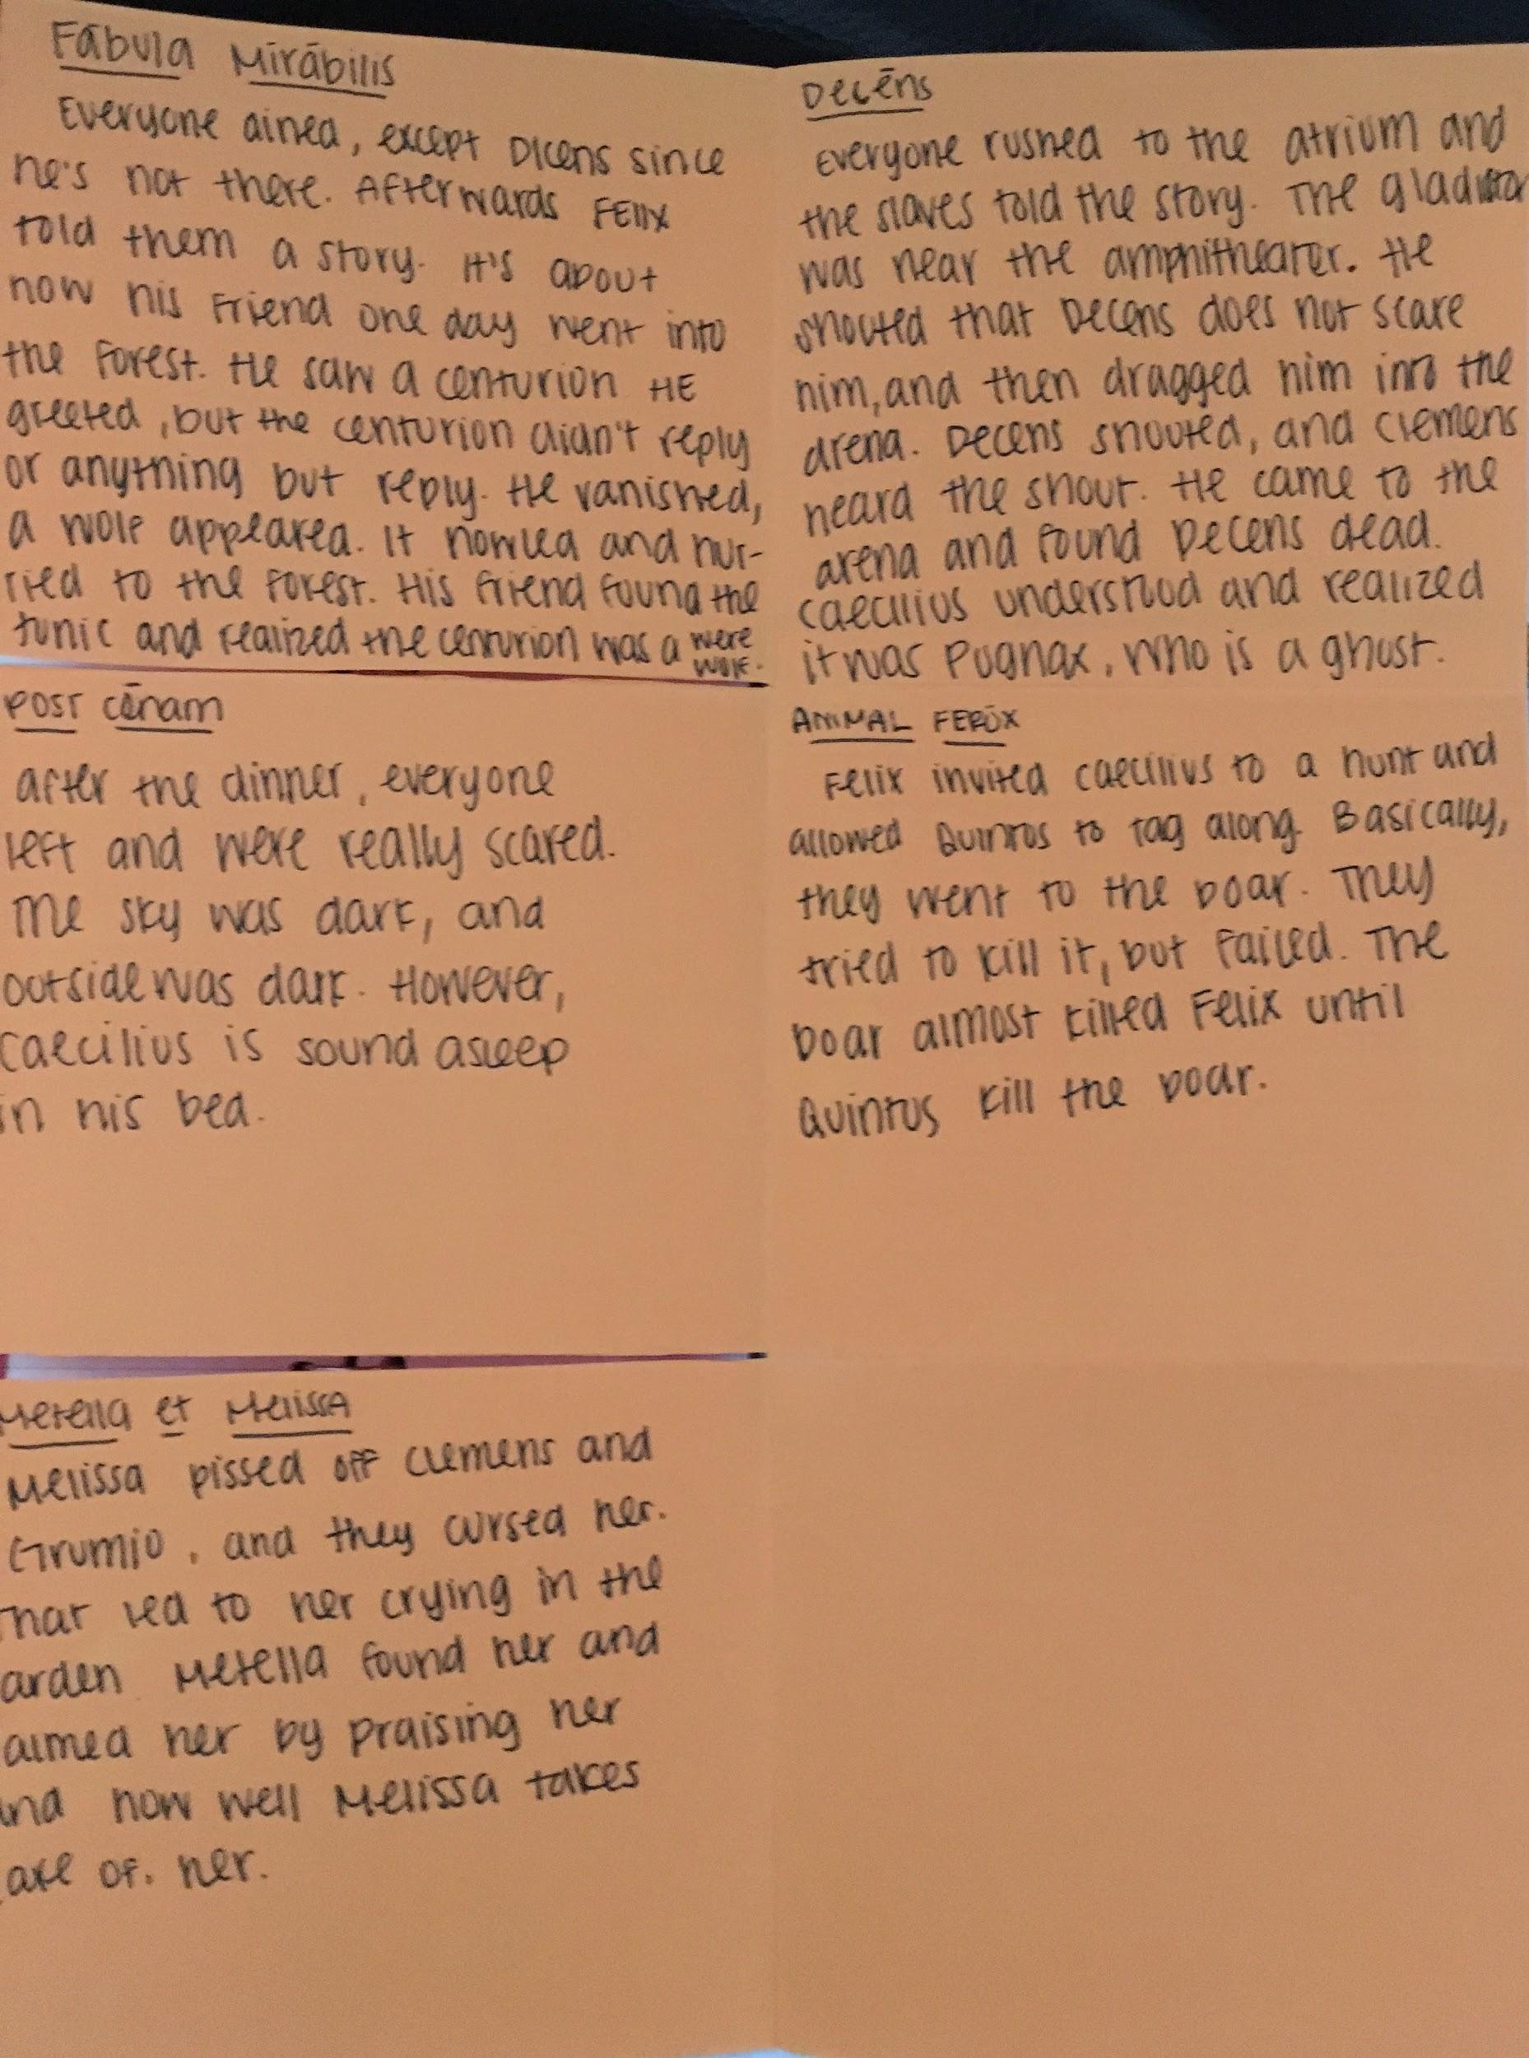
Notes:
grammar
story review

Slide 16
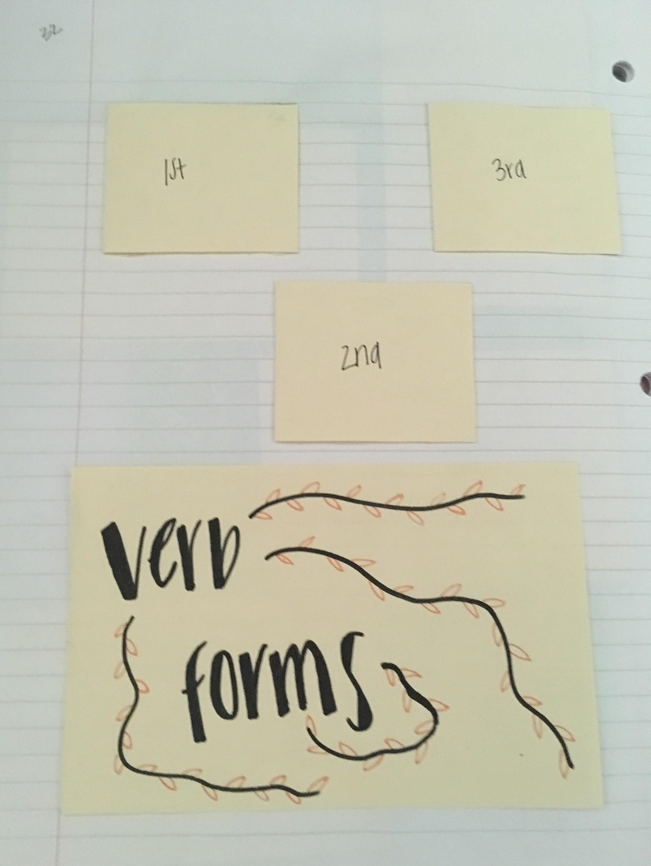
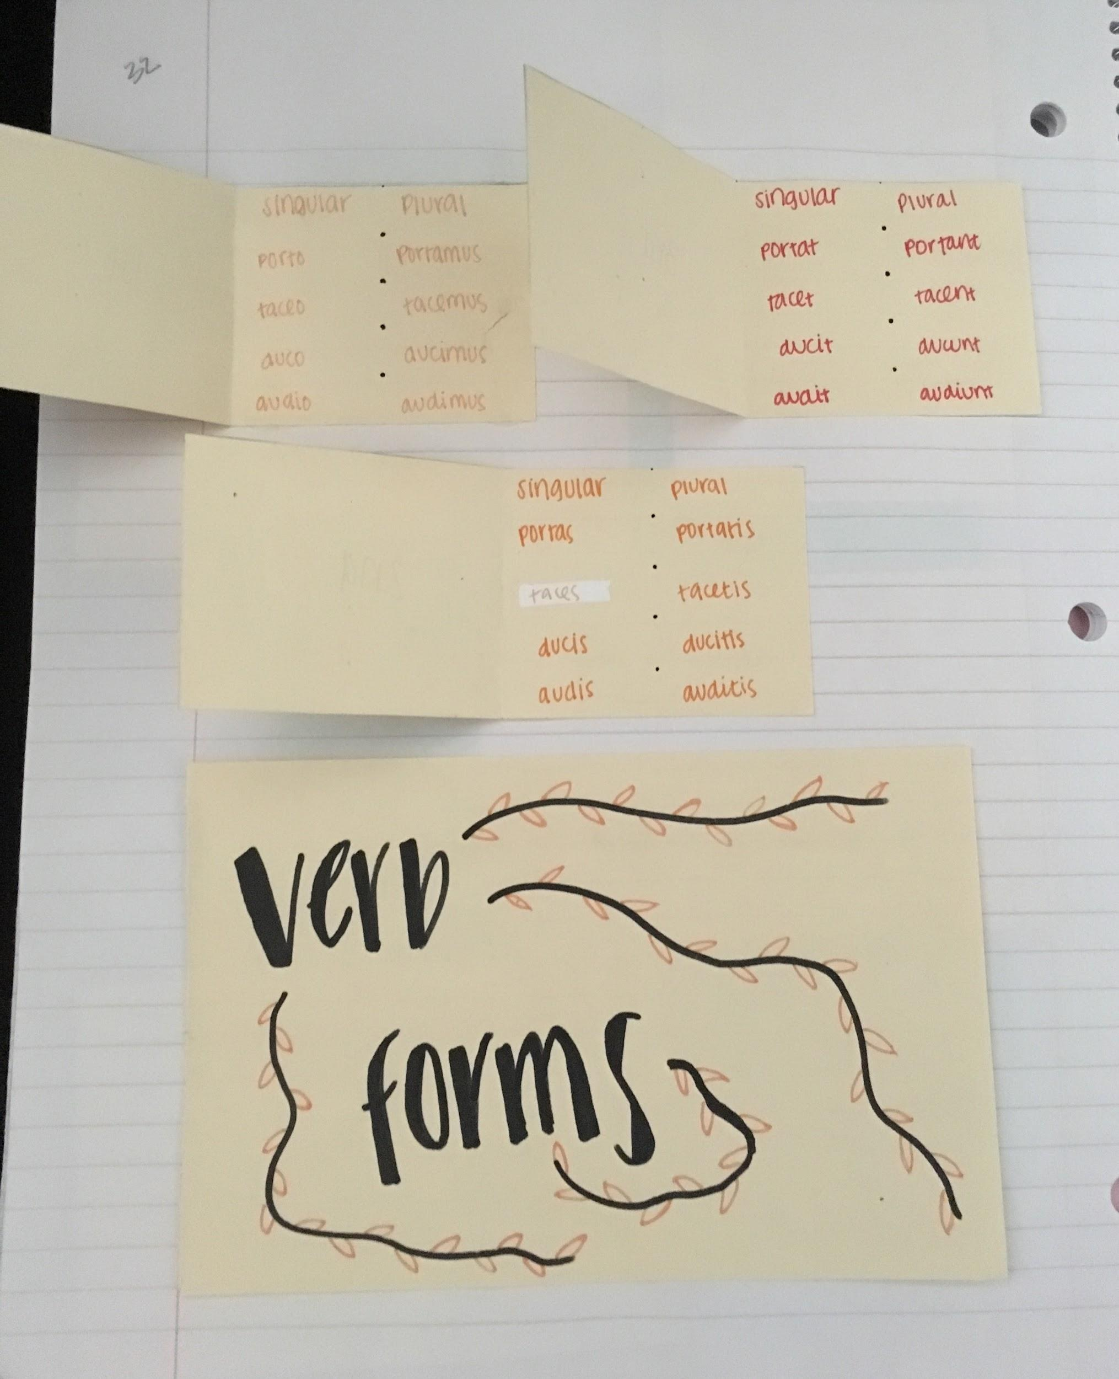
Notes:
grammar

Slide 17
Google folder link for more examples and some resources:
https://drive.google.com/open?id=0B3E5lCUFMk4-WlRPbzdhZVRmcTQ
Questions???
Rachael Clark
reclark@garlandisd.net
Notes:
Please feel free to contact me if you have questions about this presentation.

Slide 18
Bibliography
Differentiation in the Language Classroom, Susan Reese
https://www.actfl.org/sites/default/files/pdfs/TLEsamples/TLE_Aug11_Article.pdf
Differentiated Instruction in the Foreign Language Classroom: Meeting the Diverse Needs of All Students, Toni Theisen
https://www.sedl.org/loteced/communique/n06.pdf

